Slide 1
Session 26
java.sql Package

Slide 2
Review
Multithreading allows programmers to write efficient programs that make the maximum use of the CPU.
Java provides built-in support for multithreading in the form of classes and interfaces.
When Java programs are executed, there is already one thread that is running and it is the main thread.
Threads can be used in two ways:
  Declare the class to be a sub-class of the Thread class where we need to override the run method of the Thread class.
  Declare a class that implements the Runnable interface. Then define the run() method.
Each thread in a Java program is assigned a priority, and the Java Virtual Machine never changes the priority of a thread.
The default priority of a thread that is created is 5.
Data may get corrupted when two or more threads access the same variable or object at the same time.
Synchronization is a process that ensures that the resource will be used by only one thread at a time.

Slide 3
Objectives
Discuss Java Database Connectivity (JDBC)
Describe the java.sql package in brief
Discuss types of JDBC drivers
Explain the anatomy of a JDBC program
Describe the PreparedStatement interface
Use ResultSet Interface

Slide 4
Database
Database Programming
Executing SQL statements
Client / Server
Application
Database
Retrieving query results
ODBC
JDBC
Two APIs for
Java applications

Slide 5
ODBC 3-1
ODBC
(Open Database
Connectivity)
Application Programming Interface
Insert
Modify
Client / Server
GUI Application
Database
Delete

Slide 6
ODBC 3-2
Access
Driver
Access
Database
Driver
Manager
Application
ODBC
Interface
Oracle
Driver
Oracle
Database
Others…
Other
Database..
ODBC Connection

Slide 7
ODBC 3-3
Establish a connection with the database
Send SQL statement to the data source
Define the storage area to store the result set
and also the data type of the result set
Trace errors if any and process them
Get the results
Control the transactions
Terminate the connection

Slide 8
JDBC
JDBC
(Java Database
Connectivity)
Java Application Programming Interface
Java Application
Database
Communicates
Through API
objects and
methods

Slide 9
JDBC Driver types
JDBC-ODBC Bridge Plus ODBC Driver
Native API partly Java Driver
JDBC Driver types
JDBC-Net pure Java driver
Native-protocol pure Java driver

Slide 10
JDBC Architecture 2-1
Java Program
JDBC Driver
SQL Command
Results
Application Server
Database

Slide 11
JDBC Architecture 2-2
Application layer
Driver layer
Implements Interfaces
Driver
Connection
Statement
ResultSet

Slide 12
JDBC Components
import java.sql.*;
import java.util.*;
class Jdbctest2 {
public static void main(String args[]) {
try {
Class.forName("sun.jdbc.odbc.JdbcOdbcDriver");
} catch(ClassNotFoundException ce) {
System.out.println(ce);
}
try {
String url = "jdbc:odbc:test";
Connection con = DriverManager.getConnection(url);
Statement s = con.createStatement();
ResultSet rs = s.executeQuery("select hiredate,sum(salary) from friends group by hiredate");
while(rs.next()) {
System.out.print(rs.getDate(1) +"\t" );
System.out.print(rs.getInt(2) +"\t" );
System.out.println(" ");
}
} catch(SQLException ce) {
System.out.println(ce);
}
}
}
Java Application
JDBC Components
Locate the driver for
specific database
Data Source
Driver Manager
Driver
Process initialization
calls for JDBC

Slide 13
java.sql package 3-1
Interface Name | Description
CallableStatement | This contains methods that are used for execution of SQL stored procedures.
Connection | This is used to maintain and monitor database sessions. Data access can also be controlled using the transaction locking mechanism.
DatabaseMetaData | This interface provides database information such as the version number, names of the tables and functions supported.
Driver | This interface is used to create Connection objects.
PreparedStatement | This is used to execute pre-compiled SQL statements.
ResultSet | This interface provides methods for retrieving data returned by an SQL statement.
ResultSetMetaData | This interface is used to collect the meta data information associated with the last ResultSet object.
Statement | It is used to execute SQL statements and retrieve data into the ResultSet.

Slide 14
java.sql package 3-2
Class Name | Description
Date | This class contains methods for performing conversion of SQL date formats to Java Date formats.
DriverManager | This class is used to handle loading and unloading of drivers and establish connection with the database.
DriverPropertyInfo | The methods in this class are used to retrieve or insert driver properties.
Time | This class provides formatting and parsing operations for Time values.
TimeStamp | This provides precision to Java Date object by adding a Nanosecond field.
Types | This class has no methods. This class defines the constants used to identify the SQL types.

Slide 15
java.sql package 3-3
Introducing java.sql package.
The exceptions defined by the java.sql package are:
    DataTruncation
    SQLException
    SQLWarning
    BatchUpdateException
…
try{
fooBar();
catch(SQLException ex)
{
//If an SQLException is thrown, we’ll end up here.
//Output is the error message, SQLstate and vendor code.
System.out.println(“An SQLException was caught!”);
System.out.println(“Message: “ + ex.getMessage());
System.out.println(“SQLState: “ + ex.getSQLState());
System.out.println(“Vendor Code: “ + ex.getErrorCode());
}
…
Calling fooBar
…
//---
//fooBar
//---
public void foobar() throws SQLException
{
throw new SQLException(“I just threw an SQLException”);
}
…

Slide 16
Steps for Database Access
Begin
Import the java.sql
package
Load and register
the driver
Create a Connection object
Create a statement object
Execute the
statement
Close the Connection
Close Statement object
Close ResultSet object
End

Slide 17
Anatomy of a JDBC program
/** This is a main method. */
public static void main(final String [] args) {
try {
Class.forName("sun.jdbc.odbc.JdbcOdbcDriver");
} catch (ClassNotFoundException ce) {
System.out.println(ce);
}
try {
String url = "jdbc:odbc:test";
Connection con = DriverManager.getConnection(url);
Statement s = con.createStatement();
ResultSet rs = s.executeQuery("select * from friends");
while (rs.next()) {
System.out.print(rs.getString(1) + "\t");
System.out.print(rs.getString(2) + "\t");
System.out.print(rs.getInt(3) + "\t");
System.out.print(rs.getDate(4) + "\t");
System.out.println(" ");
}
} catch (SQLException ce) {
System.out.println(ce);
}
}}
It demonstrates the different steps to access a database.
Before Example 1 can be executed, a table named friends
should exist in SQL Server.
import java.sql.SQLException;
import java.sql.Connection;
import java.sql.DriverManager;
import java.sql.Statement;
import java.sql.ResultSet;
/** This class demonstrates the different steps followed to access a database.
*/
class Jdbctest {
/** Constructor. */
protected Jdbctest() {
}
Column Name | Data Type
Name | Varchar
Address | Varchar
Telephone | Numeric
HireDate | Datetime
Salary | Numeric
Friends table structure
Demonstration: Example 1

Slide 18
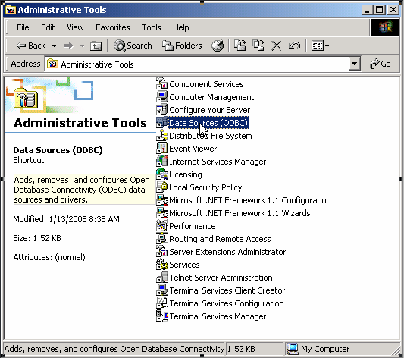
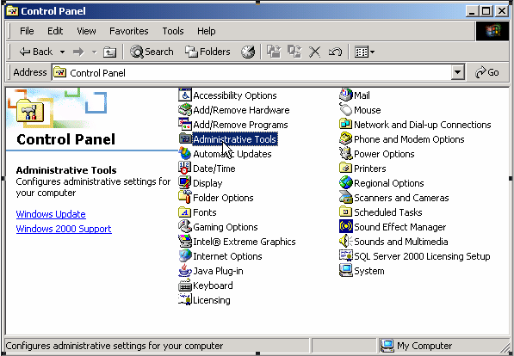
Creating a new data source 9-1
Double-Click the Administrative Tools
Select Data Sources (ODBC) icon
Click on Settings → Control Panel → Administrative Tools

Slide 19
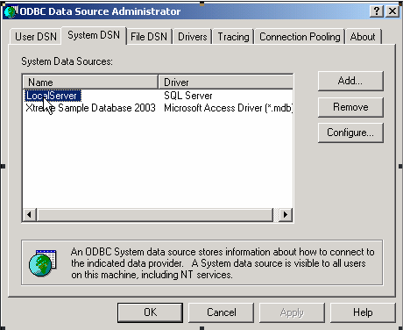
Creating a new data source 9-2
Click on Add button to open the
Create New Data Source window
Select the System DSN tab

Slide 20
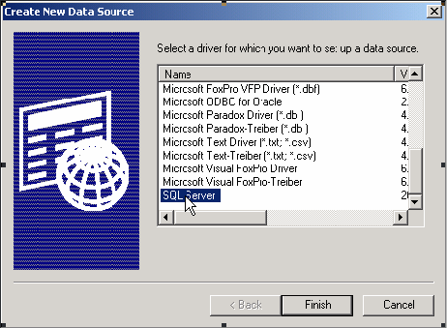
Creating a new data source 9-3
Choose SQL Server
Click on Finish button to open the Create a
New Data Source to SQL Server dialog box

Slide 21
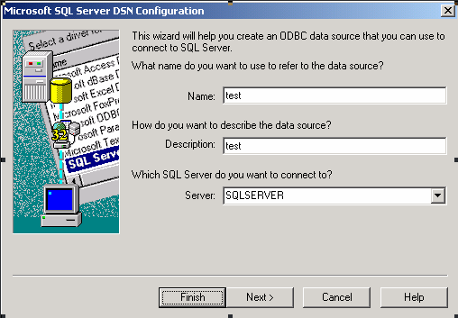
Creating a new data source 9-4
Type the data source name and description as test
and select a system name on which SQL Server is
installed. SQL Server name for example, SQL Server
Click on Next to open the option
for login authentication

Slide 22
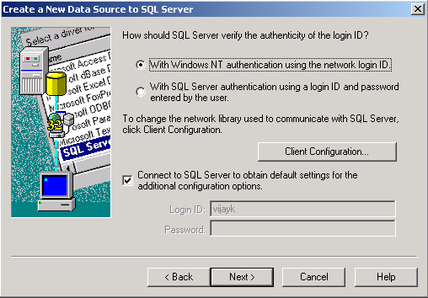
Creating a new data source 9-5
Choose the default settings
Click on Next

Slide 23
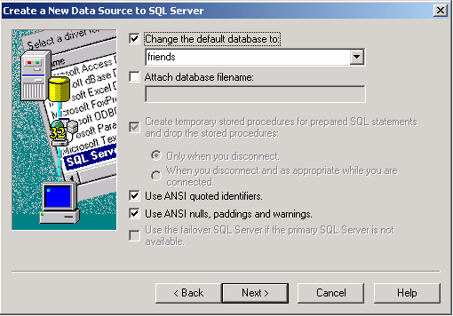
Creating a new data source 9-6
allows the user to choose
database. For this example it is friends.
Click on Finish in next
Dialog box.
Click on Next. The dialog box displays default settings.
Select default settings.

Slide 24
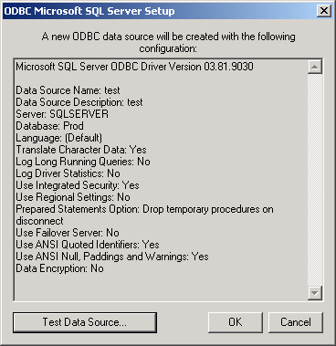
Creating a new data source 9-7
Click on Test Data Source to
check for the connection

Slide 25
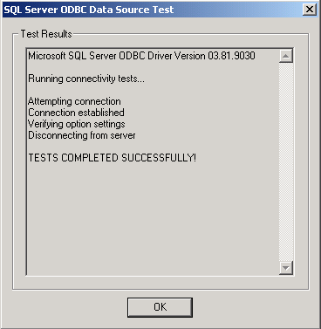
Creating a new data source 9-8
Click on OK

Slide 26
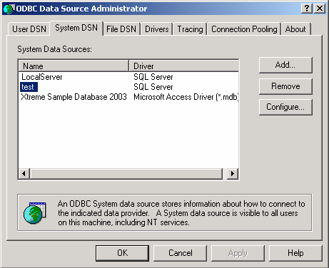
Creating a new data source 9-9
The data source name appears in the System DSN tab

Slide 27
Using SQL 5-1
Statement interface
SQL Query String
executeQuery() Method
ResultSet
Passed as an argument
Returns selected data
In SQL, query can be written as
SELECT name, email, phone FROM colleagues;
for JDBC the Java code to execute the above query would be
String str = "SELECT emp_id, lname, fname FROM colleagues";
Statement stmt = con.createStatement();
ResultSet rset = stmt.executeQuery(str);

Slide 28
Using SQL 5-2
/** This is a main method.*/
public static void main(final String [] args) {
try {
Class.forName("sun.jdbc.odbc.JdbcOdbcDriver");
} catch (ClassNotFoundException ce) {
System.out.println(ce);
} try {
String url = "jdbc:odbc:test";
Connection con = DriverManager.getConnection(url, “sa”, “playware”);
Statement s = con.createStatement();
ResultSet rs = s.executeQuery(
"select hiredate, sum(salary) from friends group by hiredate");
while (rs.next()) {
System.out.print(rs.getDate(1) + "\t");
System.out.print(rs.getInt(2) + "\t");
System.out.println(" ");
}
} catch (SQLException ce) {
System.out.println(ce);
}
}}
It demonstrates the use of sum() function in SQL.
import java.sql.SQLException;
import java.sql.Connection;
import java.sql.DriverManager;
import java.sql.Statement;
import java.sql.ResultSet;
/** This class demonstrates the use of sum() function in SQL.
*/
class Jdbctest2 {
/** Constructor. */
protected Jdbctest2() {
}
Demonstration: Example 2

Slide 29
Using SQL 5-3
It demonstrates the usage of INSERT statement in SQL.
/** This is a main method. */
public static void main(final String [] args) {
try {
Class.forName("sun.jdbc.odbc.JdbcOdbcDriver");
} catch (ClassNotFoundException ce) {
System.out.println(ce);
}
try {
String url = "jdbc:odbc:test";
String str = "INSERT INTO friends(name,address,salary)" + "VALUES('Jessica','Alaska',25690)";
Connection con = DriverManager.getConnection(url);
Statement s = con.createStatement();
int rowcount = s.executeUpdate(str);
String str1 = "select name, avg(salary) from friends"
+ " group by name";
import java.sql.SQLException;
import java.sql.Connection;
import java.sql.DriverManager;
import java.sql.Statement;
import java.sql.ResultSet;
/** This class demonstrates the usage of INSERT statement.
*/
class Jdbctest3 {
/** Constructor. */
protected Jdbctest3() {
}
ResultSet rs = s.executeQuery(str1);
while (rs.next()) {
System.out.print(rs.getString(1) + "\t");
System.out.print(rs.getInt(2) + "\t");
System.out.println(" ");
}
} catch (SQLException ce) {
System.out.println(ce);
}
}
}
Demonstration: Example 3

Slide 30
Using SQL 5-4
Statement | Syntax | Description
ALTER TABLE <tableName> | ALTER TABLE emp ADD (emp_email char(20)) | A new column called emp_email is added to the table emp of character size 20.
INSERT INTO <tableName> | INSERT INTO emp VALUES (‘Jennifer’,‘E004’,32,‘jenni@abc.com’) | The values specified here are inserted into the table emp.
DELETE FROM <tablename> | DELETE FROM emp WHERE emp_name = ‘Bradman’ | Deletes all the rows with the emp_name equal to ‘Bradman’ from the emp table.
DROP TABLE <tableName> | DROP TABLE emp | The table named ‘emp’ is permanently removed from the database.

Slide 31
Using SQL 5-5
It demonstrates the usage of commands in SQL.
public static void main(final String [] args) {
Connection con;
Statement stmt;
String url;
String sql;
try {
Class.forName("sun.jdbc.odbc.JdbcOdbcDriver");
} catch (ClassNotFoundException ce) {
System.out.println(ce);
}
try {
url = "jdbc:odbc:test";
con = DriverManager.getConnection(url);
sql = "Delete from friends where rtrim(name)like\'Kim\';";
System.out.println(" ");
stmt = con.createStatement();
stmt.executeUpdate(sql);
System.out.println("Record for Kim is deleted“);
con.close();
import java.sql.SQLException;
import java.sql.Connection;
import java.sql.DriverManager;
import java.sql.Statement;
/** This class demonstrates the usage of commands in SQL.
*/
class Jdbc2 {
/** Constructor. */
protected Jdbc2() {
}
con = DriverManager.getConnection(url);
sql = "Update friends set address=\'Adelaide\' where " + "rtrim(name) like \'Mike\'; ";
System.out.println(" ");
stmt = con.createStatement();
stmt.executeUpdate(sql);
con.close();
System.out.println("Record for Mike updated");
} catch (SQLException ce) {
System.out.println(ce);
}
}
}
Demonstration: Example 4

Slide 32
Prepared Statement interface 3-1
Statement
interface
PreparedStatement
Interface
(Precompiled SQL statements)
PreparedStatement is used
to improve runtime efficiency
Executing PreparedStatement
objects is faster than
Statement objects

Slide 33
PreparedStatement interface 3-2
CourseAppl() {
url = "jdbc:microsoft:sqlserver://";
serverName = "10.1.1.234";
portNumber = "1433";
databaseName = "Prod";
userName = "john";
password = "playware"; }
private String getConnectionUrl() {
return url + serverName + ":" + portNumber + ";databaseName =" + databaseName + ";"; }
private java.sql.Connection getConnection() {
try {
Class.forName("com.microsoft.jdbc.sqlserver.SQLServerDriver");
con = DriverManager.getConnection(
getConnectionUrl(), userName, password);
if (con != null) {
System.out.println("Connection Successful!");
}} catch (Exception e) {
e.printStackTrace();
System.out.println("Error Trace in getConnection() : " + e.getMessage()); } return con; }
public void display() {
try {
con = getConnection();
PreparedStatement pstmt = con.prepareStatement(
"UPDATE Course SET Hours= ? WHERE CourseTitle like ?");
pstmt.setInt(1, 800);
pstmt.setString(2, "Windows 2003");
pstmt.executeUpdate();
System.out.println("Record updated!");
Statement s = con.createStatement();
String sql = "SELECT * FROM Course";
ResultSet rs = s.executeQuery(sql);
while (rs.next()) {
System.out.println(" ");
System.out.print(rs.getInt(1) + " ");
System.out.print(rs.getString(2) + " ");
System.out.println(rs.getInt(3));
}} catch (SQLException ce) {
System.out.println(ce);
}} /** This is a main method. */
public static void main(final String [] args) {
CourseAppl retObj = new CourseAppl();
retObj.display(); }}
It demonstrates the usage of PreparedStatement in SQL.
import java.sql.SQLException;
import java.sql.Connection;
import java.sql.DriverManager;
import java.sql.Statement;
import java.sql.ResultSet;
import java.sql.PreparedStatement;
/** This class demonstrates the usage of PreparedStatement in SQL. */
class CourseAppl {
private Connection con;
private String url;
private String serverName;
private String portNumber;
private String databaseName;
private String userName;
private String password;
private String sql;
Demonstration: Example 5

Slide 34
PreparedStatement interface 3-3
public void display() {
try {
con = getConnection();
sql = "select * from Friends where Salary >?";
PreparedStatement pstmt = con.prepareStatement(
sql, ResultSet.TYPE_SCROLL_SENSITIVE, ResultSet.CONCUR_UPDATABLE);
pstmt.setInt(1, 5000);
ResultSet rs = pstmt.executeQuery();
while (rs.next()) {
System.out.print(rs.getString(1) + "\t");
System.out.print(rs.getString(2) + "\t");
System.out.print(rs.getInt(3) + "\t");
System.out.print(rs.getDate(4) + "\t");
System.out.print(rs.getInt(5) + "\t");
System.out.println(" ");
}} catch (SQLException ce) {
System.out.println(ce);}} /** This is a main method.*/
public static void main(final String [] args) {
RetrieveRecords retRec = new RetrieveRecords();
retRec.display(); }}
private String getConnectionUrl() {
//constructing the connection string
return url + serverName + ":" + portNumber + ";databaseName =" + databaseName + ";";
}
private java.sql.Connection getConnection() {
try{
Class.forName("com.microsoft.jdbc.sqlserver.SQLServerDriver");
con = DriverManager.getConnection(
getConnectionUrl(), userName, password);
if (con != null) {
System.out.println("Connection Successful!");
}} catch (Exception e) {
e.printStackTrace();
System.out.println("Error Trace in getConnection() : "
+ e.getMessage());
}
return con;
}
It demonstrates how to use PreparedStatement in an SQL query based upon a condition and the condition is given as an IN parameter.
import java.sql.SQLException;
import java.sql.Connection;
import java.sql.DriverManager;
import java.sql.ResultSet;
import java.sql.PreparedStatement;
/** This class demonstrates the usage of PreparedStatement in an SQL query based upon a condition.*/
class RetrieveRecords {
private Connection con;
private String url;
private String serverName, portNumber, databaseName, userName,password;
private String sql;
RetrieveRecords() {
url = "jdbc:microsoft:sqlserver://";
serverName = "10.1.1.234";
portNumber = "1433";
databaseName = "Prod";
userName = "john";
password = "playware";}
Demonstration: Example 6

Slide 35
Working with ResultSets 3-1
ResultSet objects are entirely dependent on the Statement and Connection objects.
Each time an SQL statement is executed, the resultset is overwritten with new results.
The ResultSet object gets automatically closed when the related Statement is closed.
next()
getRow()
get<Type>()
positions the cursor
down one row from its
current position
Determines the current
row number
Returns the data from
the ResultSet object
set of functions

Slide 36
Working with ResultSets 3-2
It demonstrates the processing of current Row.
Using the next() method, records are processed in a
sequential manner.
The processing of data in each row must be achieved in
the order in which they are returned.
…
ResultSet rset = stmt.getResultSet();
while(rset.next())
{
String dept_name = rset.getString(1);
}
…

Slide 37
Working with ResultSets 3-3
To retrieve the value of column emp_id, the getString() method is passed the value 1.
It demonstrates the processing of current Column.
Columns can be directly accessed using the get<Type>()
method.
…
Statement stmt = con.createStatement();
Stmt.executeQuery("Select emp_id, fname from Employee") ;
ResultSet rset = stmt.getResultSet();
while(rset.next())
{
String ename = rset.getString ("fname");
System.out.println ( ename) ;
}
…
…
Statement stmt = con.createStatement();
stmt.executeQuery("Select emp_id, fname from Employee");
ResultSet rset = stmt.getResultSet();
while(rset.next())
{
String employeeid = rset.getString (1);
}
…

Slide 38
Types of Result Sets 3-1
Result sets
Scrollable
Non scrollable
Cursor will move forward only
TYPE_FORWARD_ONLY
Cursor can move in both directions
and can also be moved to a particular
row relative to current position
TYPE_SCROLL_INSENSITIVE
If changes are made to database
then new values are visible
TYPE_SCROLL_SENSITIVE

Slide 39
Types of Result Sets 3-2
try {
String url = "jdbc:odbc:test";
Connection con = DriverManager.getConnection(url, “sa”, “playware”);
Statement s = con.createStatement(
ResultSet.TYPE_SCROLL_INSENSITIVE, ResultSet.CONCUR_READ_ONLY);
ResultSet rs = s.executeQuery("select * from friends");
rs.afterLast();
while (rs.previous()) {
System.out.print(rs.getString(1) + "\t");
System.out.print(rs.getString(2) + "\t");
System.out.print(rs.getInt(3) + "\t");
System.out.print(rs.getDate(4) + "\t");
System.out.println(" ");
}
} catch (SQLException ce) {
System.out.println(ce);
}}
}
import java.sql.SQLException;
import java.sql.Connection;
import java.sql.DriverManager;
import java.sql.Statement;
import java.sql.ResultSet;
/** This class demonstrates the use of various ResultSet.*/
class JdbctestReverse {
/** Constructor. */
protected JdbctestReverse() {
}
/** This is a main method.*/
public static void main(final String [] args) {
try {
Class.forName("sun.jdbc.odbc.JdbcOdbcDriver");
} catch (ClassNotFoundException ce) {
System.out.println(ce);
}
It demonstrates the use of various Result Sets.
Demonstration: Example 7

Slide 40
Types of Result Sets 3-3
ResultSet rs = stmt.executeQuery("select * from friends ");
rs.moveToInsertRow();
rs.updateString("Name", "Jack");
rs.updateString("Address", "Tokyo");
rs.updateInt("salary", 65000);
rs.insertRow();
rs.beforeFirst();
System.out.println("Table FRIENDS after insertion:");
while (rs.next()) {
String name = rs.getString("Name");
String address = rs.getString("Address");
int salary = rs.getInt("Salary");
System.out.print(name + "\t" + address + "\t" + salary);
System.out.println(" ");
}
rs.close();
stmt.close();
con.close();
} catch (SQLException ce) {
ce.printStackTrace();
System.out.println(ce);
}}}
import java.sql.SQLException;
import java.sql.Connection;
import java.sql.DriverManager;
import java.sql.Statement;
import java.sql.ResultSet;
/** This class demonstrates the different steps followed to access a database*/
class Jdbctest {
/** Constructor. */
protected Jdbctest() {
}/** This is a main method */
public static void main(final String [] args) {
try {
Class.forName("sun.jdbc.odbc.JdbcOdbcDriver");
} catch (ClassNotFoundException ce) {
System.out.println(ce);}
try {
String url = "jdbc:odbc:test";
Connection con = DriverManager.getConnection(url);
Statement stmt = con.createStatement(
ResultSet.TYPE_SCROLL_SENSITIVE,ResultSet.CONCUR_UPDATABLE);
It creates a result set object, rs, which is scrollable, updatable and sensitive to changes.
It demonstrates the different steps followed to access a
database.
Demonstration: Example 8

Slide 41
Summary
Java Database Connectivity (JDBC) Application Programming Interface (API) is a part of the Java APIs provided by Sun Microsystems that defines a set of API objects and methods to interact with databases.
The JDBC classes are present in the java.sql package and all Java programs that need to interact with databases use methods from this package. The driver is loaded into the Java interpreter using Class.forName() method.
The driver is loaded into the java interpreter using the Class.forname method
Establish a connection using the getConnection() method of DriverManager class and use the createStatement() method of the Connection object .
Finally, SQL statements are constructed and executed through the statement instance by using either executeQuery() or executeUpdate() methods.
The PreparedStatement interface allows us to create pre-compiled SQL statements and gives the option of specifying the parameters for the statement at a later stage.
ResultSet can be scrollable or non scrollable and first(), last(), afterLast(), beforeFirst() are some of the methods for moving the cursor in result set.

